Slide 1
Canisolair Efficiency Monitoring System
Applied Research Project by: Dylan Stone

Slide 2
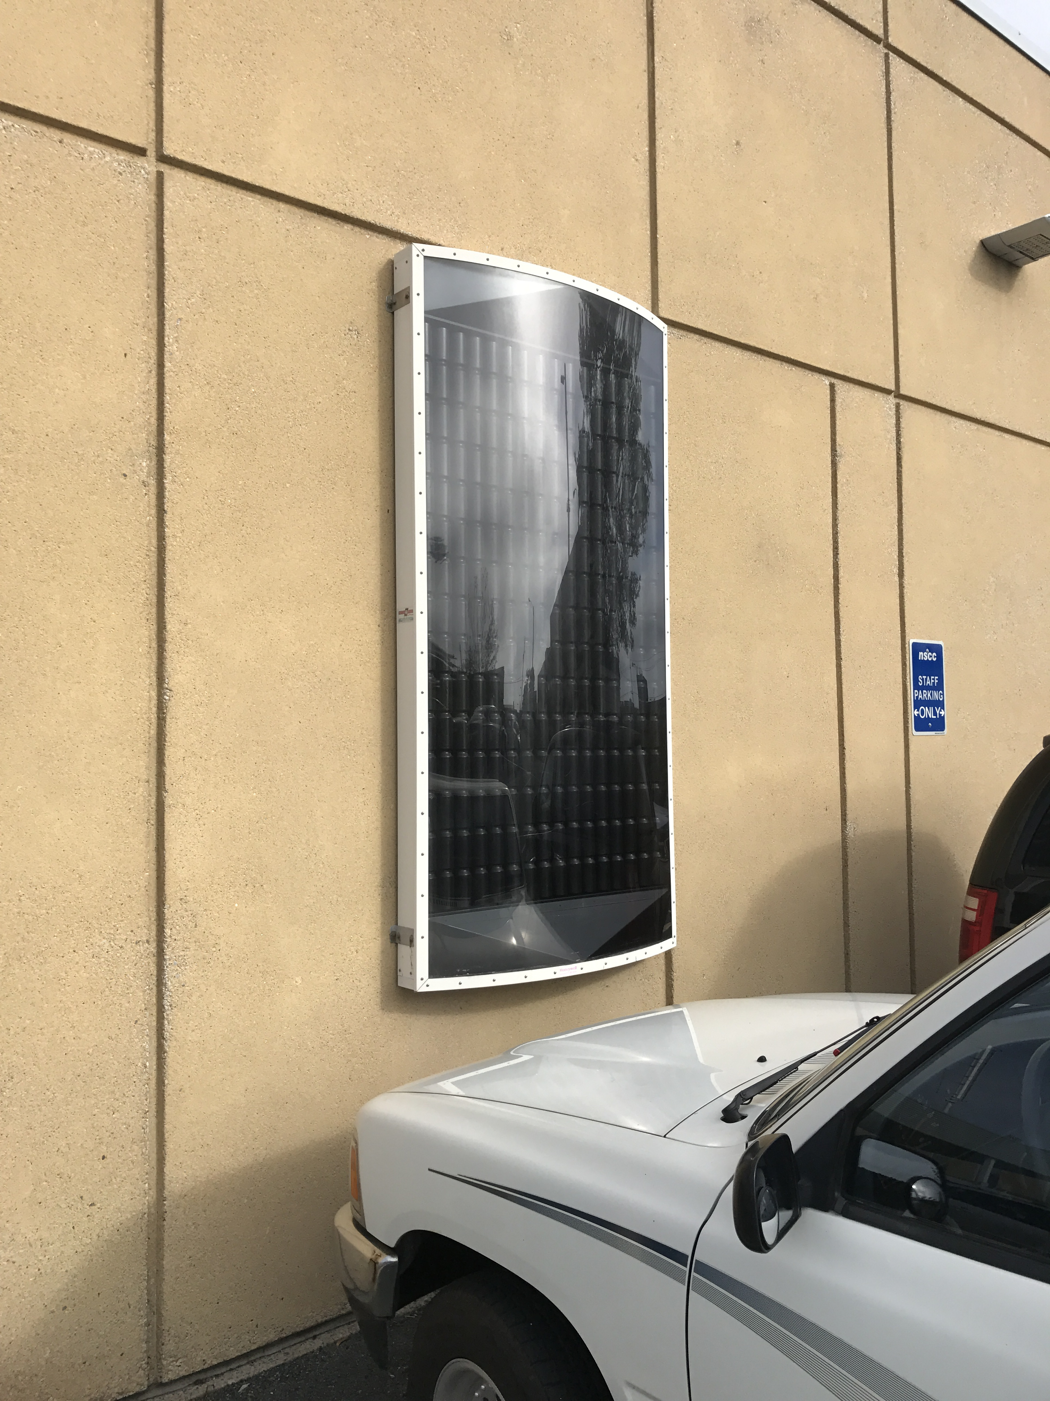
Canisolair Solar Heater
Solar Heater
Built from recycled pop cans
Built-in fan and thermostat
Claim it can heat 8 000 cu. Ft.
Check Valves
Claim up to 2900 Watts of heat
Draws 31 Watts while running
Claimed 47 LPS flow rate
Expensive, nearly $3 000 plus installation

Slide 3
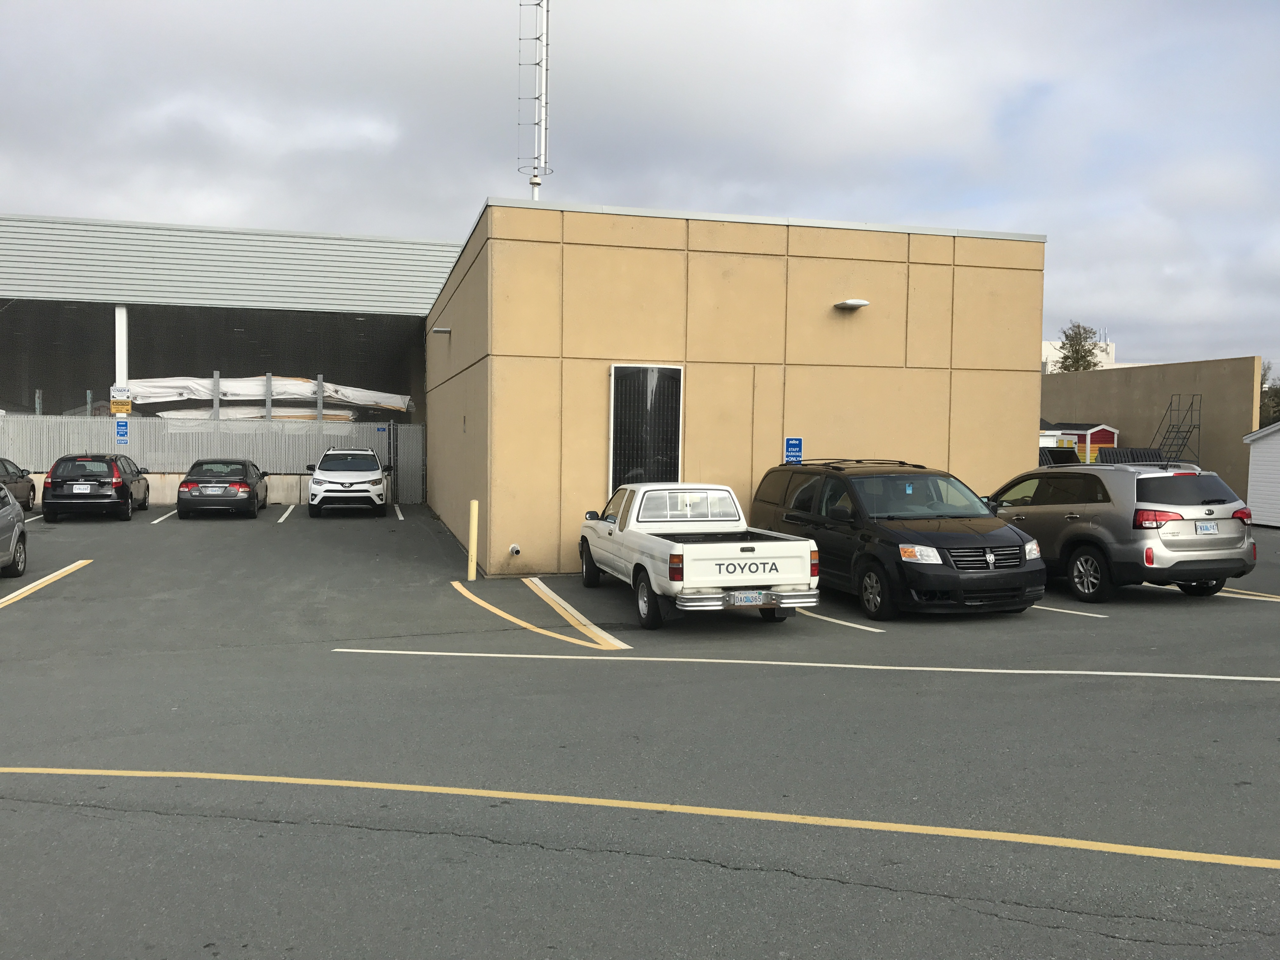
What I’m doing
Information Gathering
Temperature
Flow rate
Daily Solar Intensity
Calculations
Temperature Differential
Solar Intensity
Data Logging
Remote
Local

Slide 4
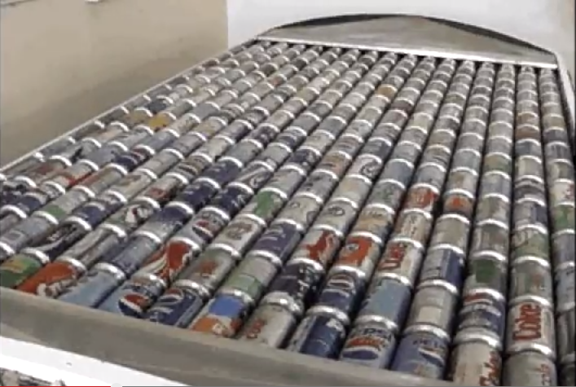
Why I’m doing it
With Applied Research
Efficiency is not accurately known
Output as variable as the weather
Heat Generation vs. Cost

Slide 5
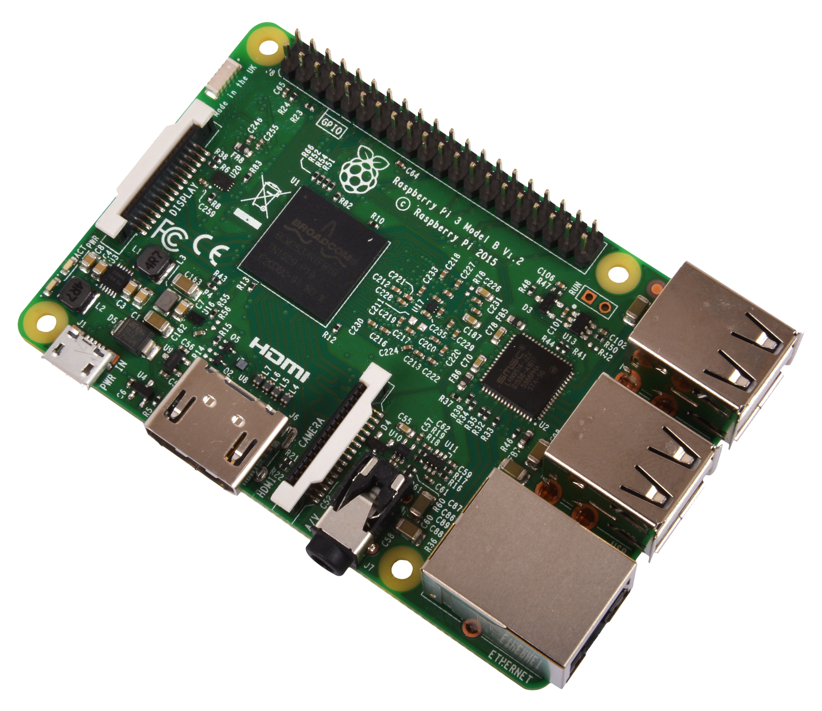
Milestones
Raspberry Pi Temperature Acquisition
Air Flow Data
Printing a Circuit Board

Slide 6
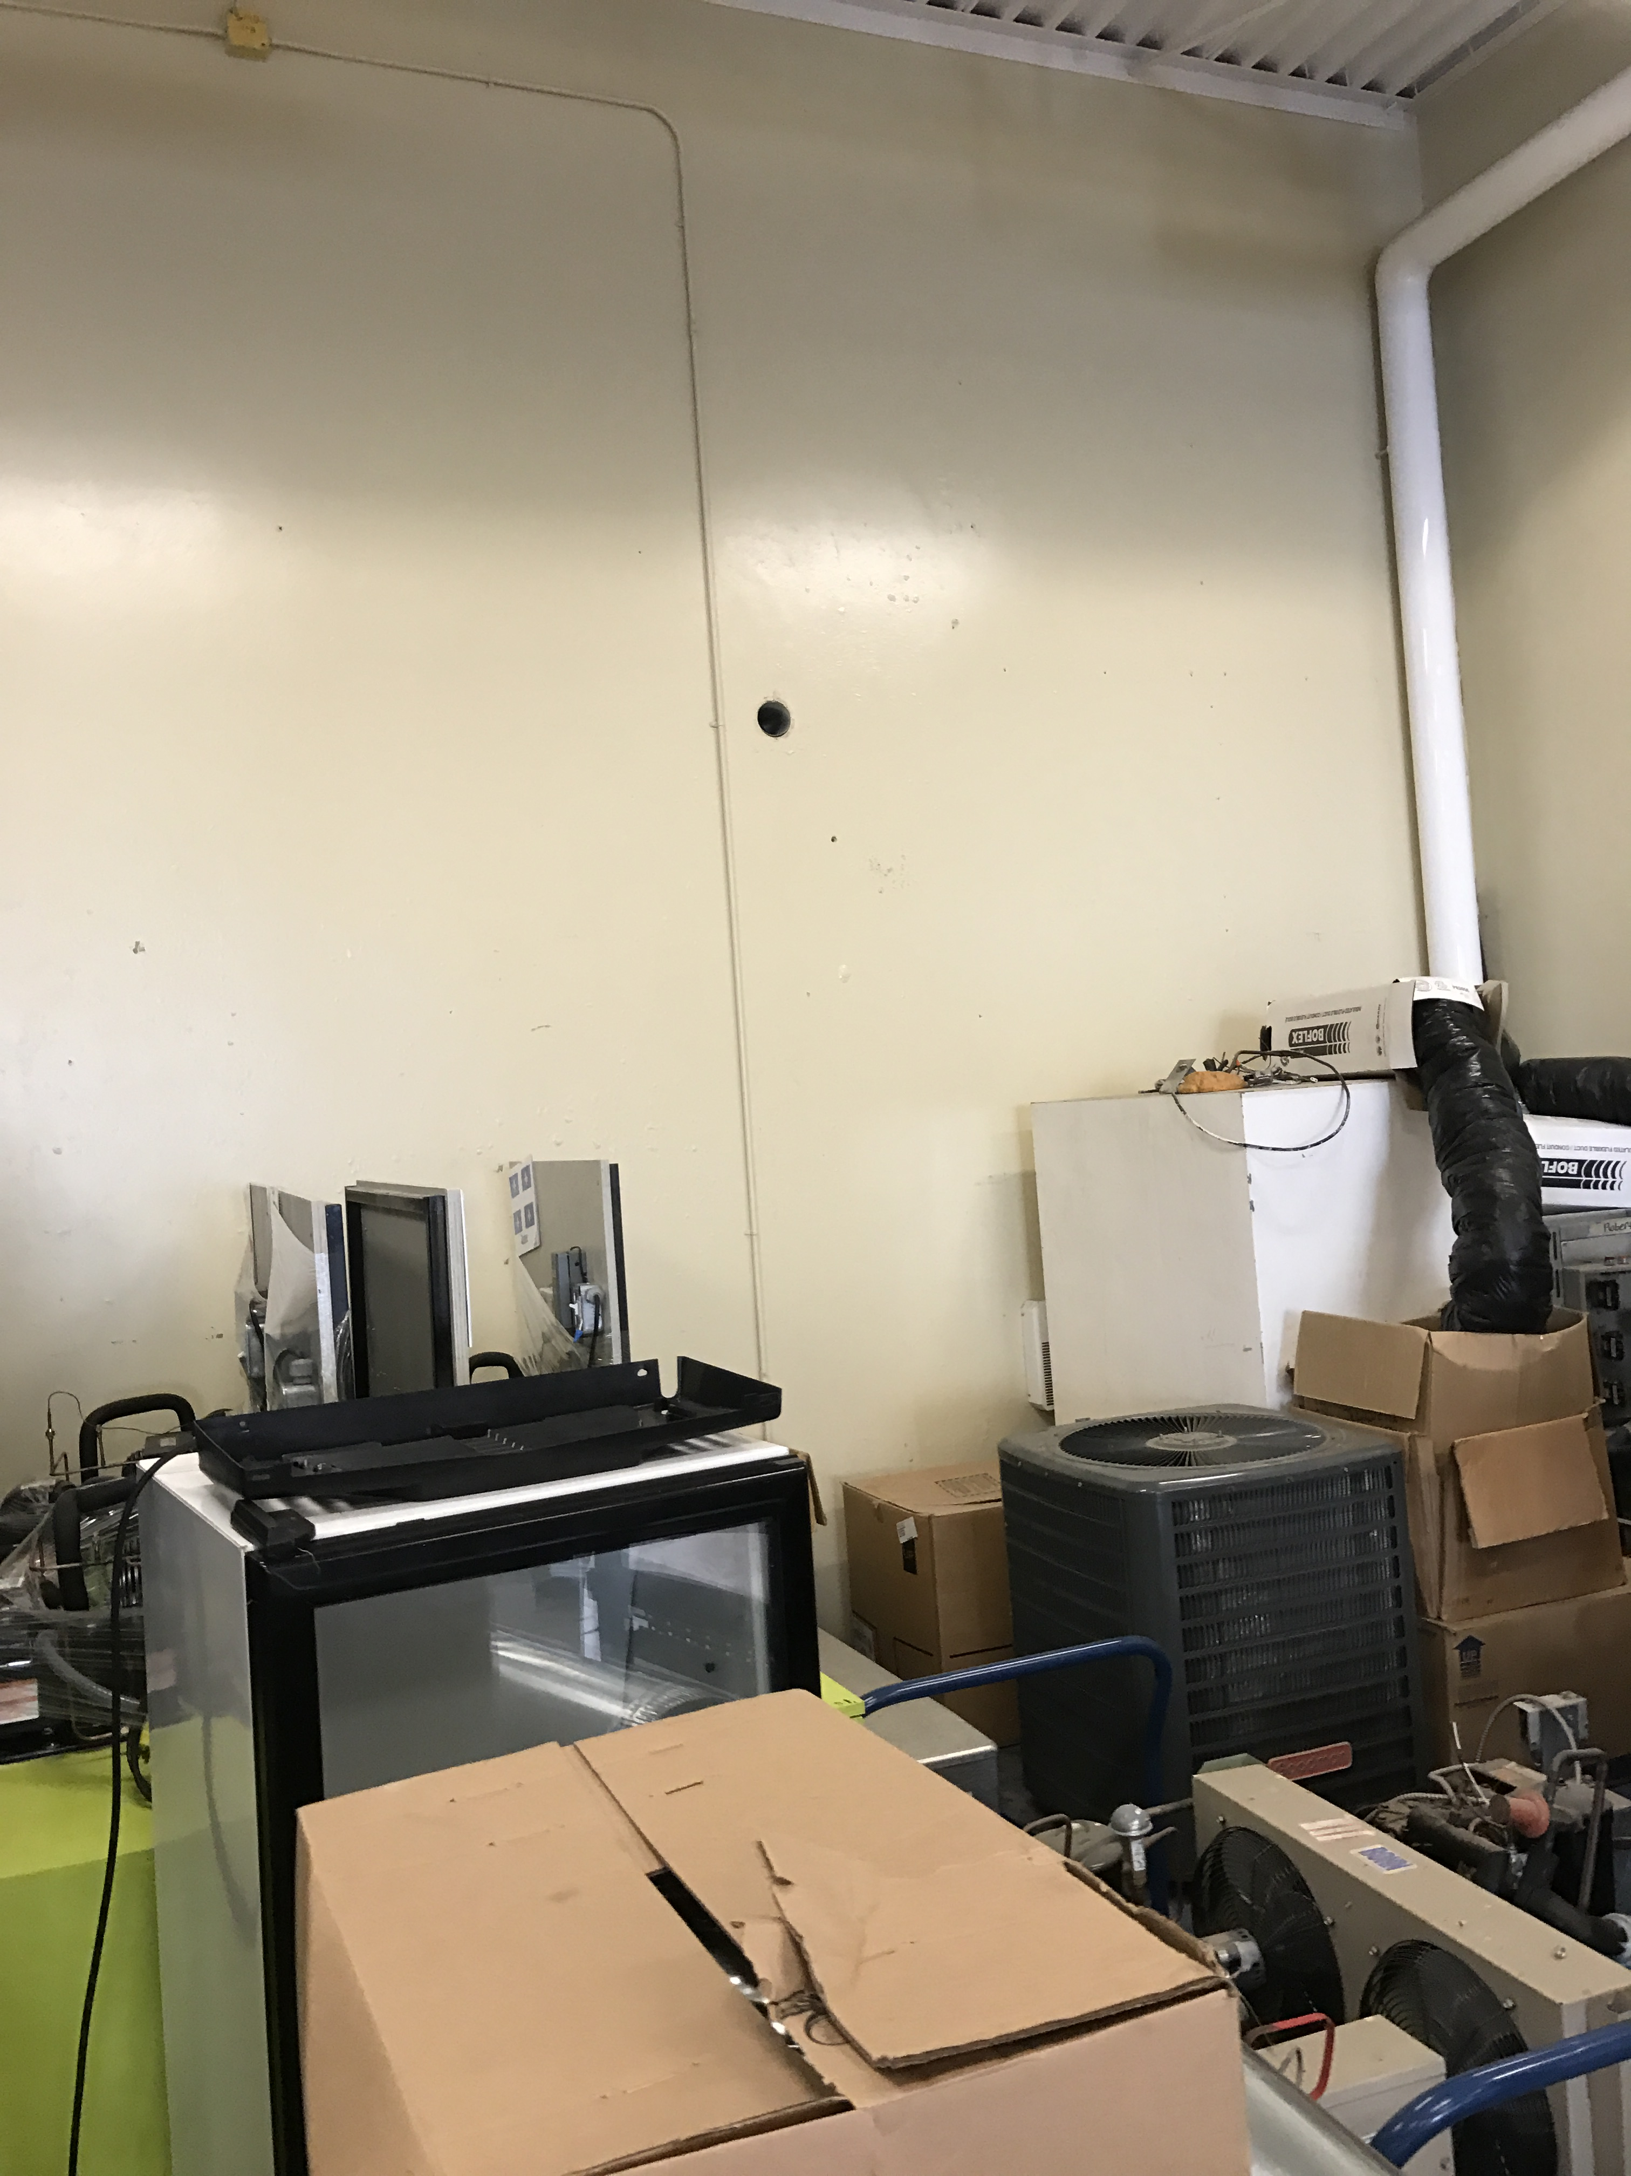
Potential Problems
Air flow
Solar Intensity
Remote Data Acquisition

